Slide 1
Gas Gap Solutions
Here is where we begins

Slide 2
Gas Gap Solutions
Here is where we begins

Slide 3
Gas Gap Solutions
Enter
Here is where we begins

Slide 4
Gas Gap Solutions
Here is where we begins

Slide 5

Contents of the Report
Introduction
The Identified Problem
Aims of the project
Data Analysis & Dashboard
Expected results
Root Cause Analysis: Categorizing the Symptoms
Information & Transparency Failure
Process & Bureaucracy Failure
Quality & Standards Failure
Proposed Solutions & Improvement Initiatives
Digital Transformation & Process Automation
Process Standardization & Transparency
Improved Communication & Customer Service
Quality Assurance & Safety
Conclusion

Slide 6
Table of Contents
01
02
03
04
The Identified Problem
major operational gap exists between national production capacity and the residential connection process
Aims of the project
Address the delays in connecting natural gas to households in Egypt by following a structured approach
Our Process
Data Analysis & Dashboard Expected results Root Cause Analysis
Proposed Solutions
Digital Transformation
Process Standardization & Transparency
Improved Communication
Quality Assurance & Safety

Slide 7
01
Introduction
Shot brief about Gas in Egypt

Slide 8
Introduction
Egypt possesses a significant natural gas resource base, with proven reserves estimated between 63 and 93.5 trillion cubic feet (Tcf), ranking it among the top in Africa.
The 2015 discovery of the supergiant Zohr field (holding an estimated 30 Tcf) was a critical inflection point that fundamentally altered the nation's production capacity and energy balance.
The country has developed extensive midstream and export infrastructure, including two operational LNG export terminals (Idku and Damietta) and a vast pipeline network for domestic and international trade, notably the Arab Gas Pipeline.
The synergy between its substantial resources and advanced infrastructure enabled Egypt to achieve energy self-sufficiency in 2018, transitioning from a net importer to a net exporter and solidifying its status as a regional energy powerhouse.

Slide 9
02
Identified Problem
The Identified Problem is A Systemic Failure ??

Slide 10
Identified Problem
Problem Description
Infrastructure gaps: Many rural and low-income areas are still not connected to the gas network.
High costs: Despite subsidies and installment plans, connection costs remain a burden for some households.
Administrative complexity: Applicants must provide multiple documents (ownership/rental contract, electricity bill, national ID, payment of fees), which can be challenging.
Production decline: Gas output dropped in 2025 to 3.48 bcm compared to 4.26 bcm the previous year, while domestic demand continues to grow.
Major operational gap exists between national production capacity and the residential connection process.
This gap creates:
1.Citizen frustration and distrust.
2.A barrier to wider natural gas adoption.
3.Potential safety and quality risks.

Slide 11
03
Aims of the project
Identify, Analyze, Develop

Slide 12
Aims of the project
This project aims to Address the delays in connecting natural gas to households in Egypt by following a structured approach:
Identify the Causes of Delays
Collect data from customers, gas companies, and government sources.
Highlight the most common issues such as long waiting times, complicated paperwork, and lack of coordination.
Uncover the Root Causes
Go beyond surface problems to find the underlying reasons.
Examples: outdated administrative systems, shortage of workforce, limited resources, or weak communication between stakeholders.
Analyze the Problem
Use data analysis tools to measure the impact of each cause.
Compare performance across regions and identify patterns (e.g., delays higher in rural vs. urban areas).
Propose Effective Solutions
Suggest practical, citizen-centered improvements such as digital applications, faster approval processes, better customer service, and transparent progress tracking.
Prioritize solutions that can improve efficiency, reduce delays, and increase customer satisfaction.

Slide 13
04
Process
Understand, Analyze, RCA

Slide 14
Understanding the Problem
Collect
Reveiw
Discuss
Analyze
Fix
Gather

Slide 15
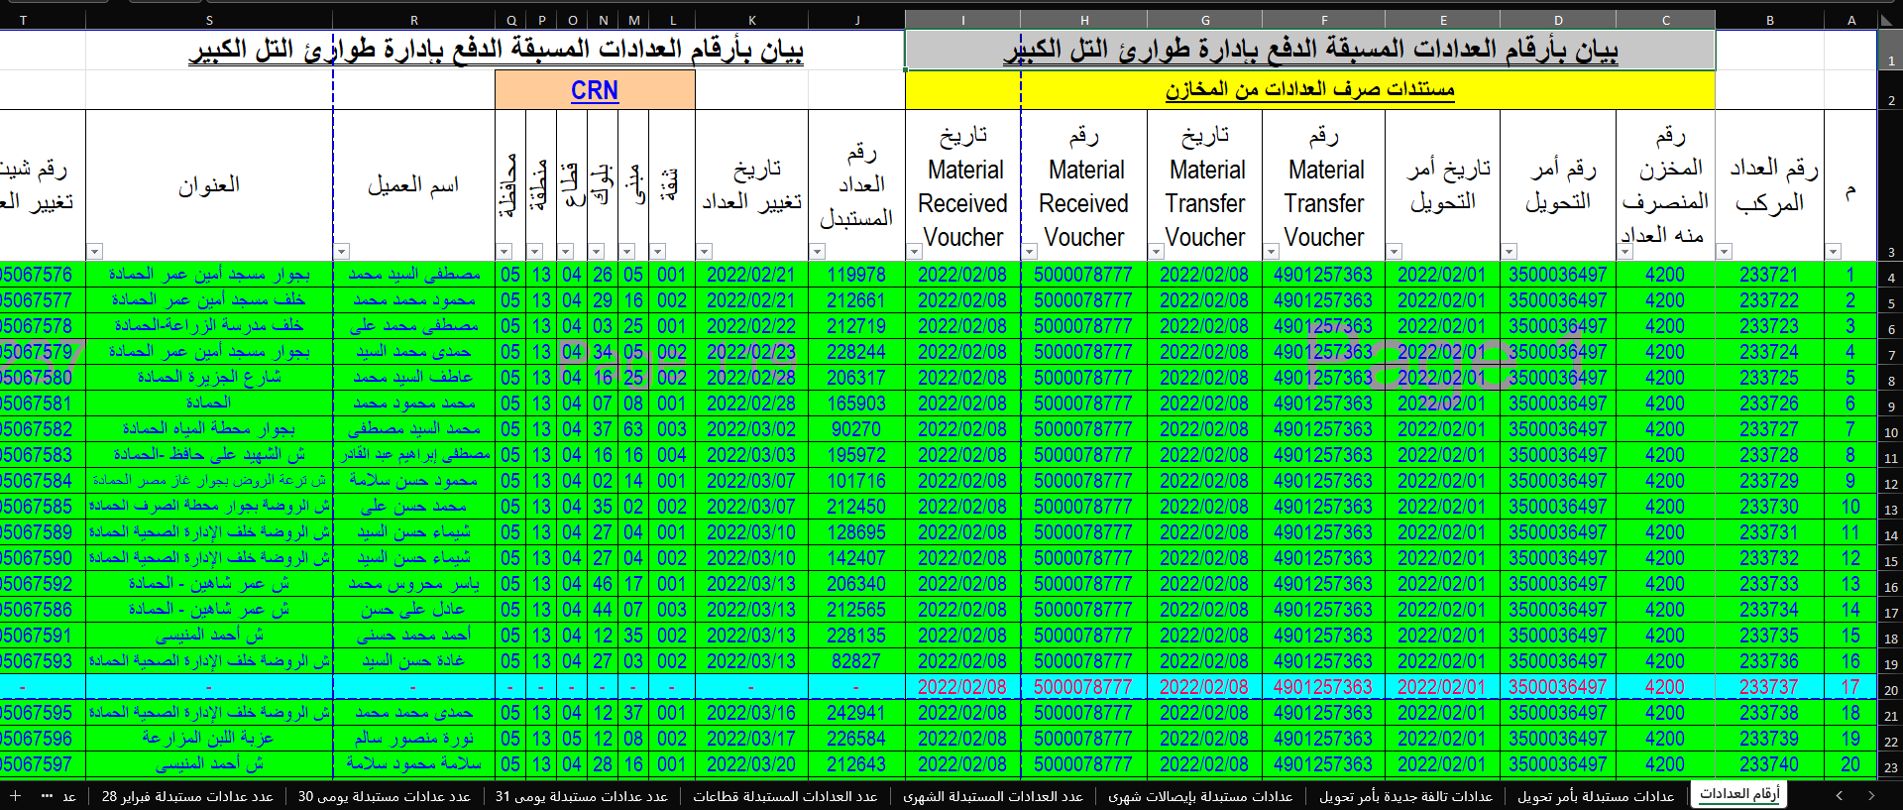
Data Analysis & Dashboard
Collecting Data from Gas Companies through phone, Emails and site visits

Slide 16
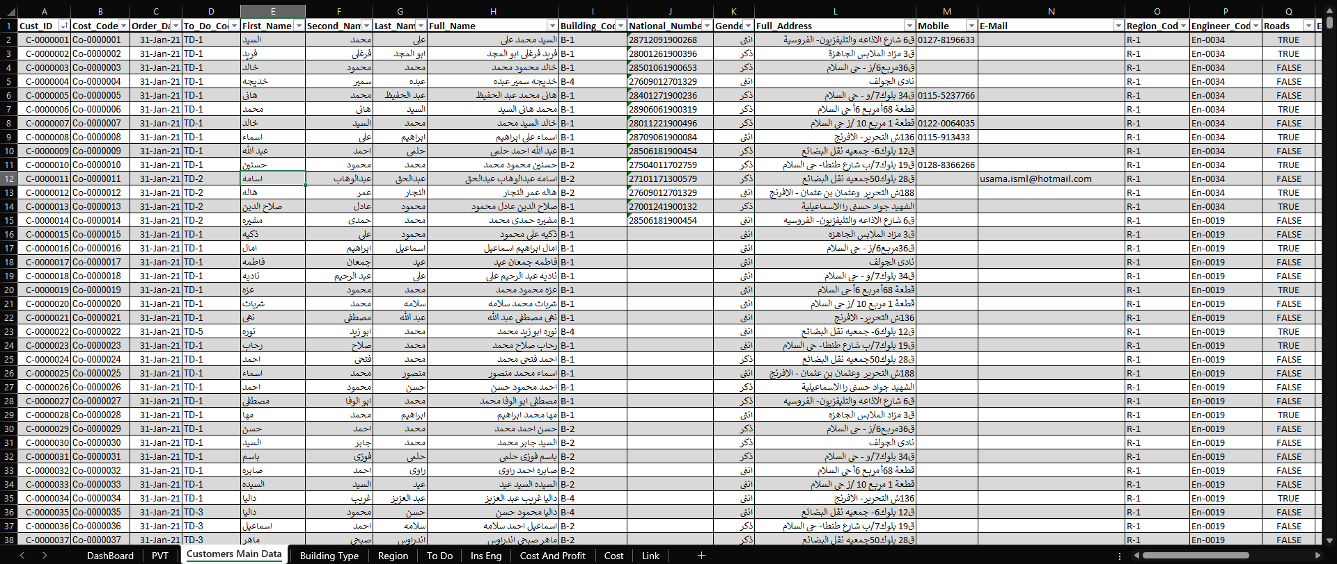
Data Analysis & Dashboard
Data Cleaning and Transformation Process to arrange and settle dataset Analysis

Slide 17
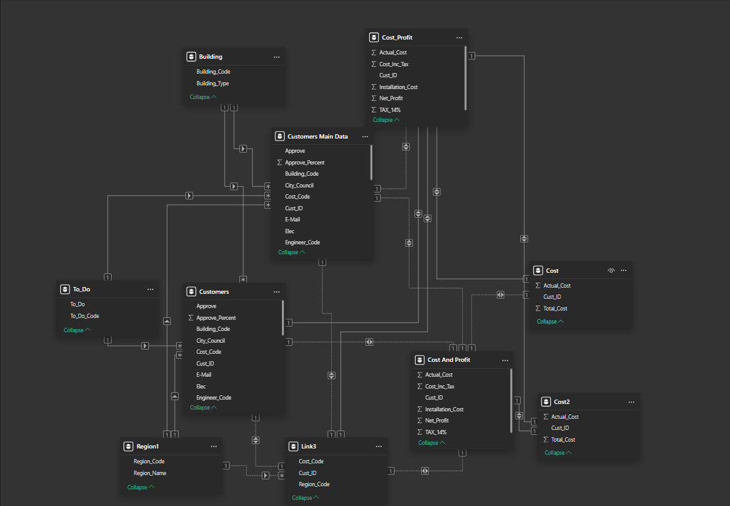
Data Analysis & Dashboard
Make Relationships between tables

Slide 18
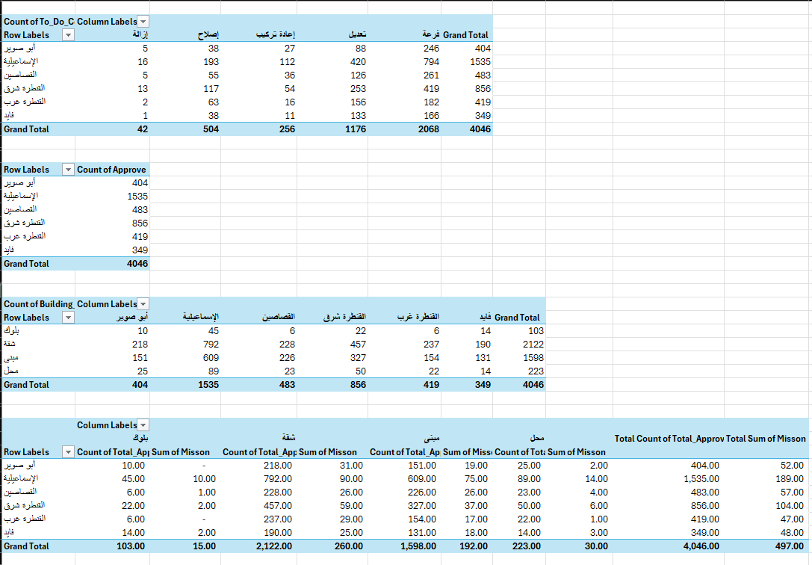
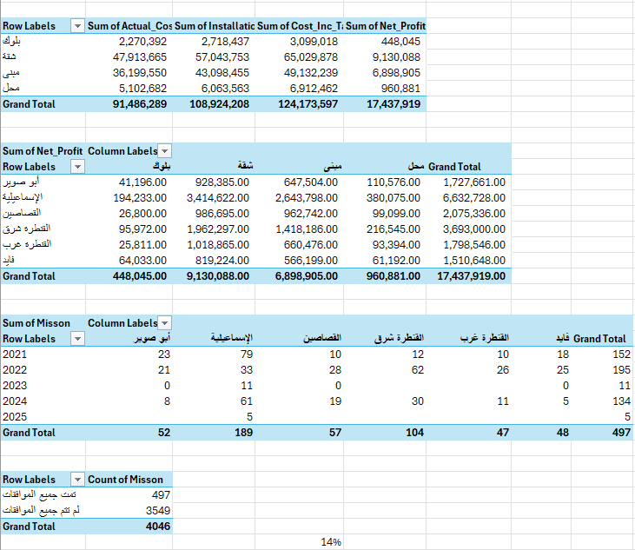
Data Analysis & Dashboard
Discuss insights and Pivot tables to review and make Dashboard Report

Slide 19
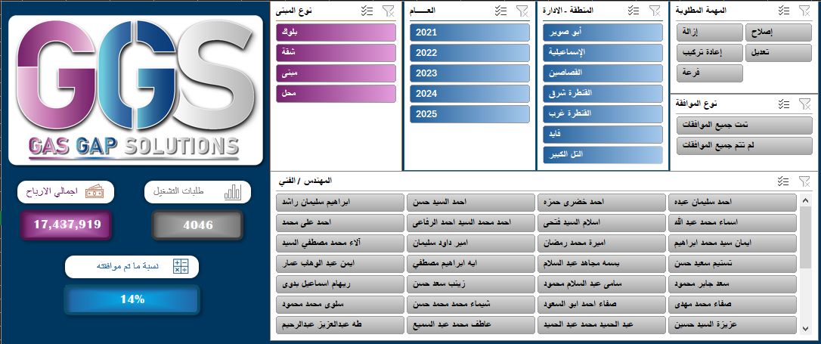
Data Analysis & Dashboard
Design Dashboard Layout and Home page Contains Slicers

Slide 20
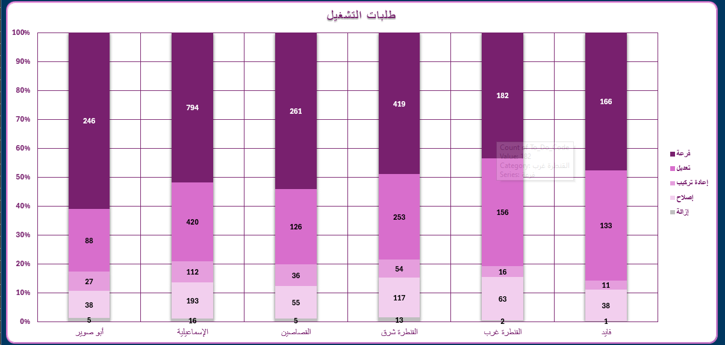
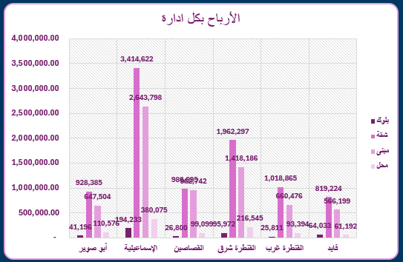
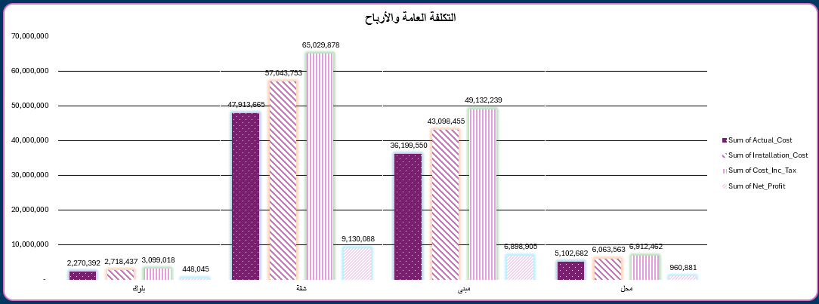
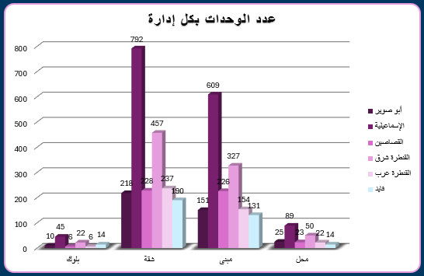
Data Analysis & Dashboard

Slide 21
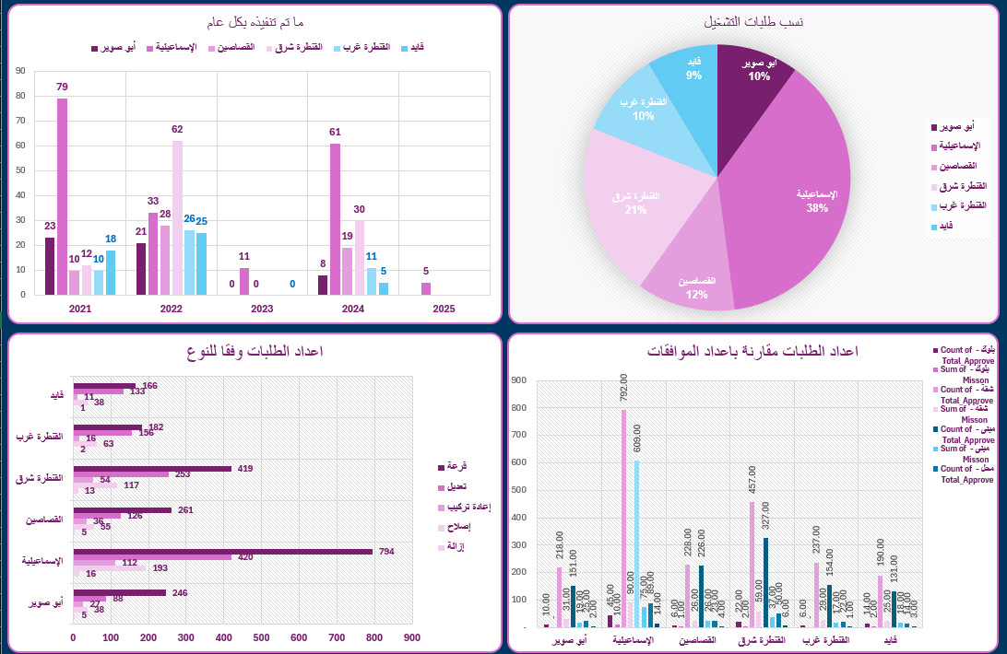
Data Analysis & Dashboard

Slide 22
Target
Acceptance Percentage
√
×
Orders and Profits
2025
13%
87%
2024
13%
87%
2023
13%
87%
2022
13%
87%
2021
17%
83%

Slide 23
Root Cause Analysis
The challenges are symptoms of three interconnected systemic failures:
1. Information & Transparency Failure:
Unclear requirements: Citizens are often unsure about the documents and approvals needed, leading to repeated visits and wasted time.
Uncertain timelines & costs: No clear guidance on how long the process will take or the exact fees involved, creating frustration and mistrust.
Poor communication channels: Lack of responsive customer support and absence of digital platforms to track progress, leaving applicants uninformed.
2. Process & Bureaucracy Failure:
Manual, paper-based workflows: Reliance on physical paperwork makes the process slow, error-prone, and prone to loss of documents.
Inefficient scheduling: Customers wait for long periods without knowing when technicians will arrive.
No tracking system: Applicants cannot monitor the status of their request, which increases uncertainty and dissatisfaction.
3. Quality & Standards Failure:
Variable installation quality: Different contractors or technicians may apply different standards, leading to safety risks and inconsistent outcomes.
Safety concerns: Poorly executed installations can create hazards for households.
Unpredictable costs: Because of non-standardized practices, additional or hidden costs often appear, causing financial strain for citizens.

Slide 24
05
Solutions
Easy, Trust, Connect, Safe

Slide 25
Our Solutions
Easy
Trust
01
02
Digital Transformation & Process Automation
Process Standardization & Transparency
Connect
Safe
03
04
Improved Communication & Customer Service
Quality Assurance, training & Safety

Slide 26
Our Solutions
Easy
Digital Transformation & Process Automation
Develop a Comprehensive Online Portal & Mobile App
Functionality:
Allow citizens to Apply online, upload required documents (scanned copies of ID, property deed, etc.)
pay fees electronically, and receive a unique tracking number.
Real-Time Tracking: Implement a status tracker (Receive, Schedule, Install, Completed)
Transparent Pricing Calculator: An online tool where citizens can input their property details (distance from main line, number of appliances) to get a more accurate, standardized cost estimate.

Slide 27
Our Solutions
Trust
Process Standardization & Transparency
Create a Standardized Citizen's Charter:
A clear, simple document (available online and in service centers) outlining:
Exact list of required documents.
A step-by-step guide to the entire process.
A standardized, itemized price list for all possible components and labor (approved by regulatory bodies).
A defined maximum service timeline for each step (Survey within 10 working days of application).
2. Mandatory Detailed Quotation: Before any work begins, provide a final, binding quotation that itemizes all costs (meter cost, internal piping, labor, etc.). Any subsequent changes must be communicated and approved by the citizen in writing.

Slide 28
Our Solutions
Connect
Improved Communication & Customer Service
Automated SMS/Email Notifications: Send automatic alerts for application confirmation, survey/installation appointments (with a 2-hour time window), and status updates.
Centralized Customer Service Hub: Establish a dedicated call center and online chat support with trained staff who can access application details and provide accurate information, reducing the need for physical visits.
Safe
Quality Assurance & Safety
Certified Technician Program: Implement a mandatory training and certification program for all installation technicians, ensuring uniform quality and safety standards and Train Clients how to Deal with Emergency.
Post-Installation Audit & Feedback: Conduct random quality checks on completed installations. Integrate a customer feedback system (a quick SMS survey) after service completion to monitor performance and identify issues.

Slide 29
Awesome Words

Slide 30
Our Process
Start Collecting Data and Connect Companies through
site visits and Phone Calls
Understanding the Problem, Analyze Data and Root Cause Analysis
Date 1
Date 2
Date 3
Date 4
Review and Discuss the collected Data Offline & Online to Get more Insights
Fix Issues, Gathering Analized Data and Design
an Interactive Dashboard

Slide 31
Our Process
Date

Slide 32
Our Process
Start Collecting Data and Connect Companies through
site visits and Phone Calls
Understanding the Problem, Analyze Data and Root Cause Analysis
8/9
18/9
23/9
30/9
Review and Discuss the collected Data Offline & Online to Get more Insights
Fix Issues, Gathering Analized Data and Design
an Interactive Dashboard

Slide 33
Whoa!
Here we are reaching the End
So, it’s Time for a Short Brief …

Slide 34
Who We Are
Samy Abdel Salam
Technology Expert
Team Leader
Mahmoud Sami
Ola Abdeltwab
Assistant professor
Civil Engineer
Mohamed Nasser
Gihad Khaled
Banker
Merchandiser
Mahmoud Ebraik
Hala Nour eldin
HSE Engineer
Production Engineer

Slide 35
Who We Are

Slide 36
Who We Are
Samy Abdel Salam
Technology Expert
Team Leader
Mahmoud Sami
Ola Abdeltwab
Assistant professor
Civil Engineer
Mohamed Nasser
Gihad Khaled
Banker
Merchandiser
Mahmoud Ebraik
Hala Nour eldin
HSE Engineer
Production Engineer

Slide 37
Gratitude
Dr Mohamed Elnajjar
Data Analysis Instructor
Eng Ahmed Abd-Elreheem
Electrical Engineer
Dr Amira Abdeltwab
soft skills/freelance trainer

Slide 38
Conclusion
Problem
Information & Transparency Failure
Process & Bureaucracy Failure
Quality & Standards Failure
Solutions
Digital Transformation & Process Automation
Process Standardization & Transparency
Improved Communication & Customer Service
Quality Assurance & Safety

Slide 39
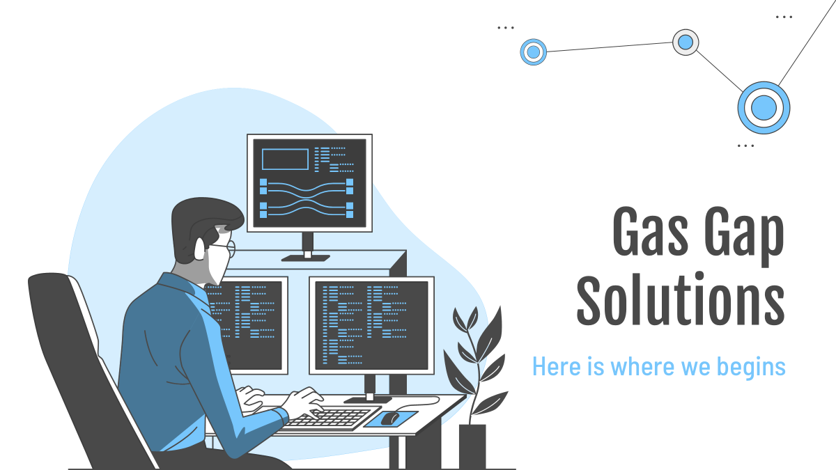
Software & Tools
SQL
Excel
Power BI
Tableau
Power Point

Slide 40
Thanks!
Do you have any questions?

